Slide 1
Capstone The Battle of the Neighborhoods
Opening a wine bar around manhattan

Slide 2
Introduction
Saving accounts have very low interest rate. Thus, I want to invest a portion of my savings into a commercial business to generate higher income.
My passion is Wine tasting and living in New York → the goal is to find the most suitable neighborhood in New York to open a successful Wine Bar.
CRITERIA
The Wine Bar will be around Manhattan.
The Wine Bar will be nearby other restaurants. Perfect for a glass of wine after work and before dinner.
The Wine Bar will be located in a neighborhood with other similar wine bars. If they are operating it probably means that it is the right area to open a new one.

Slide 3
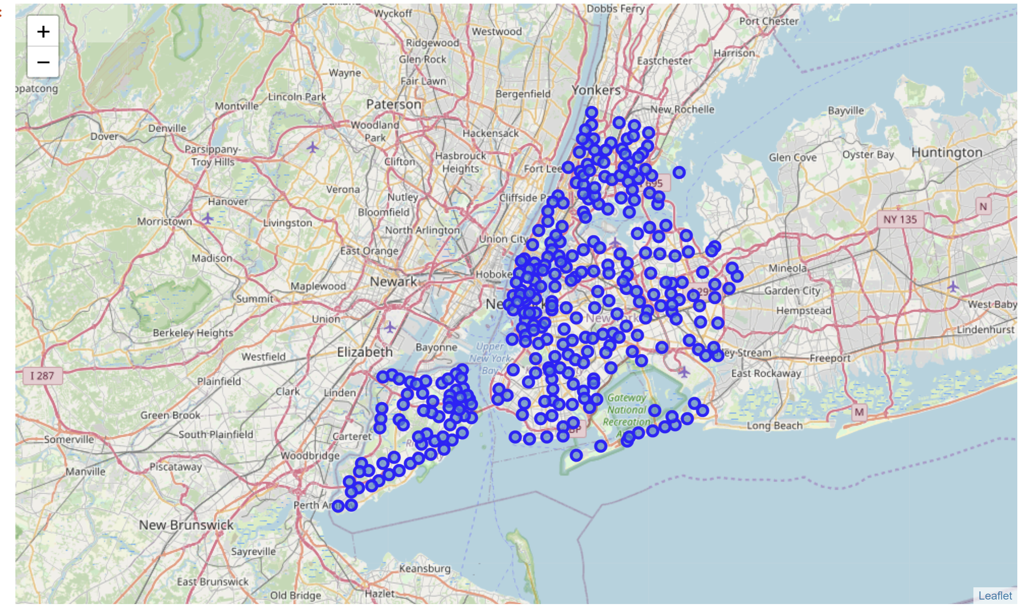
Map of the new York area

Slide 4
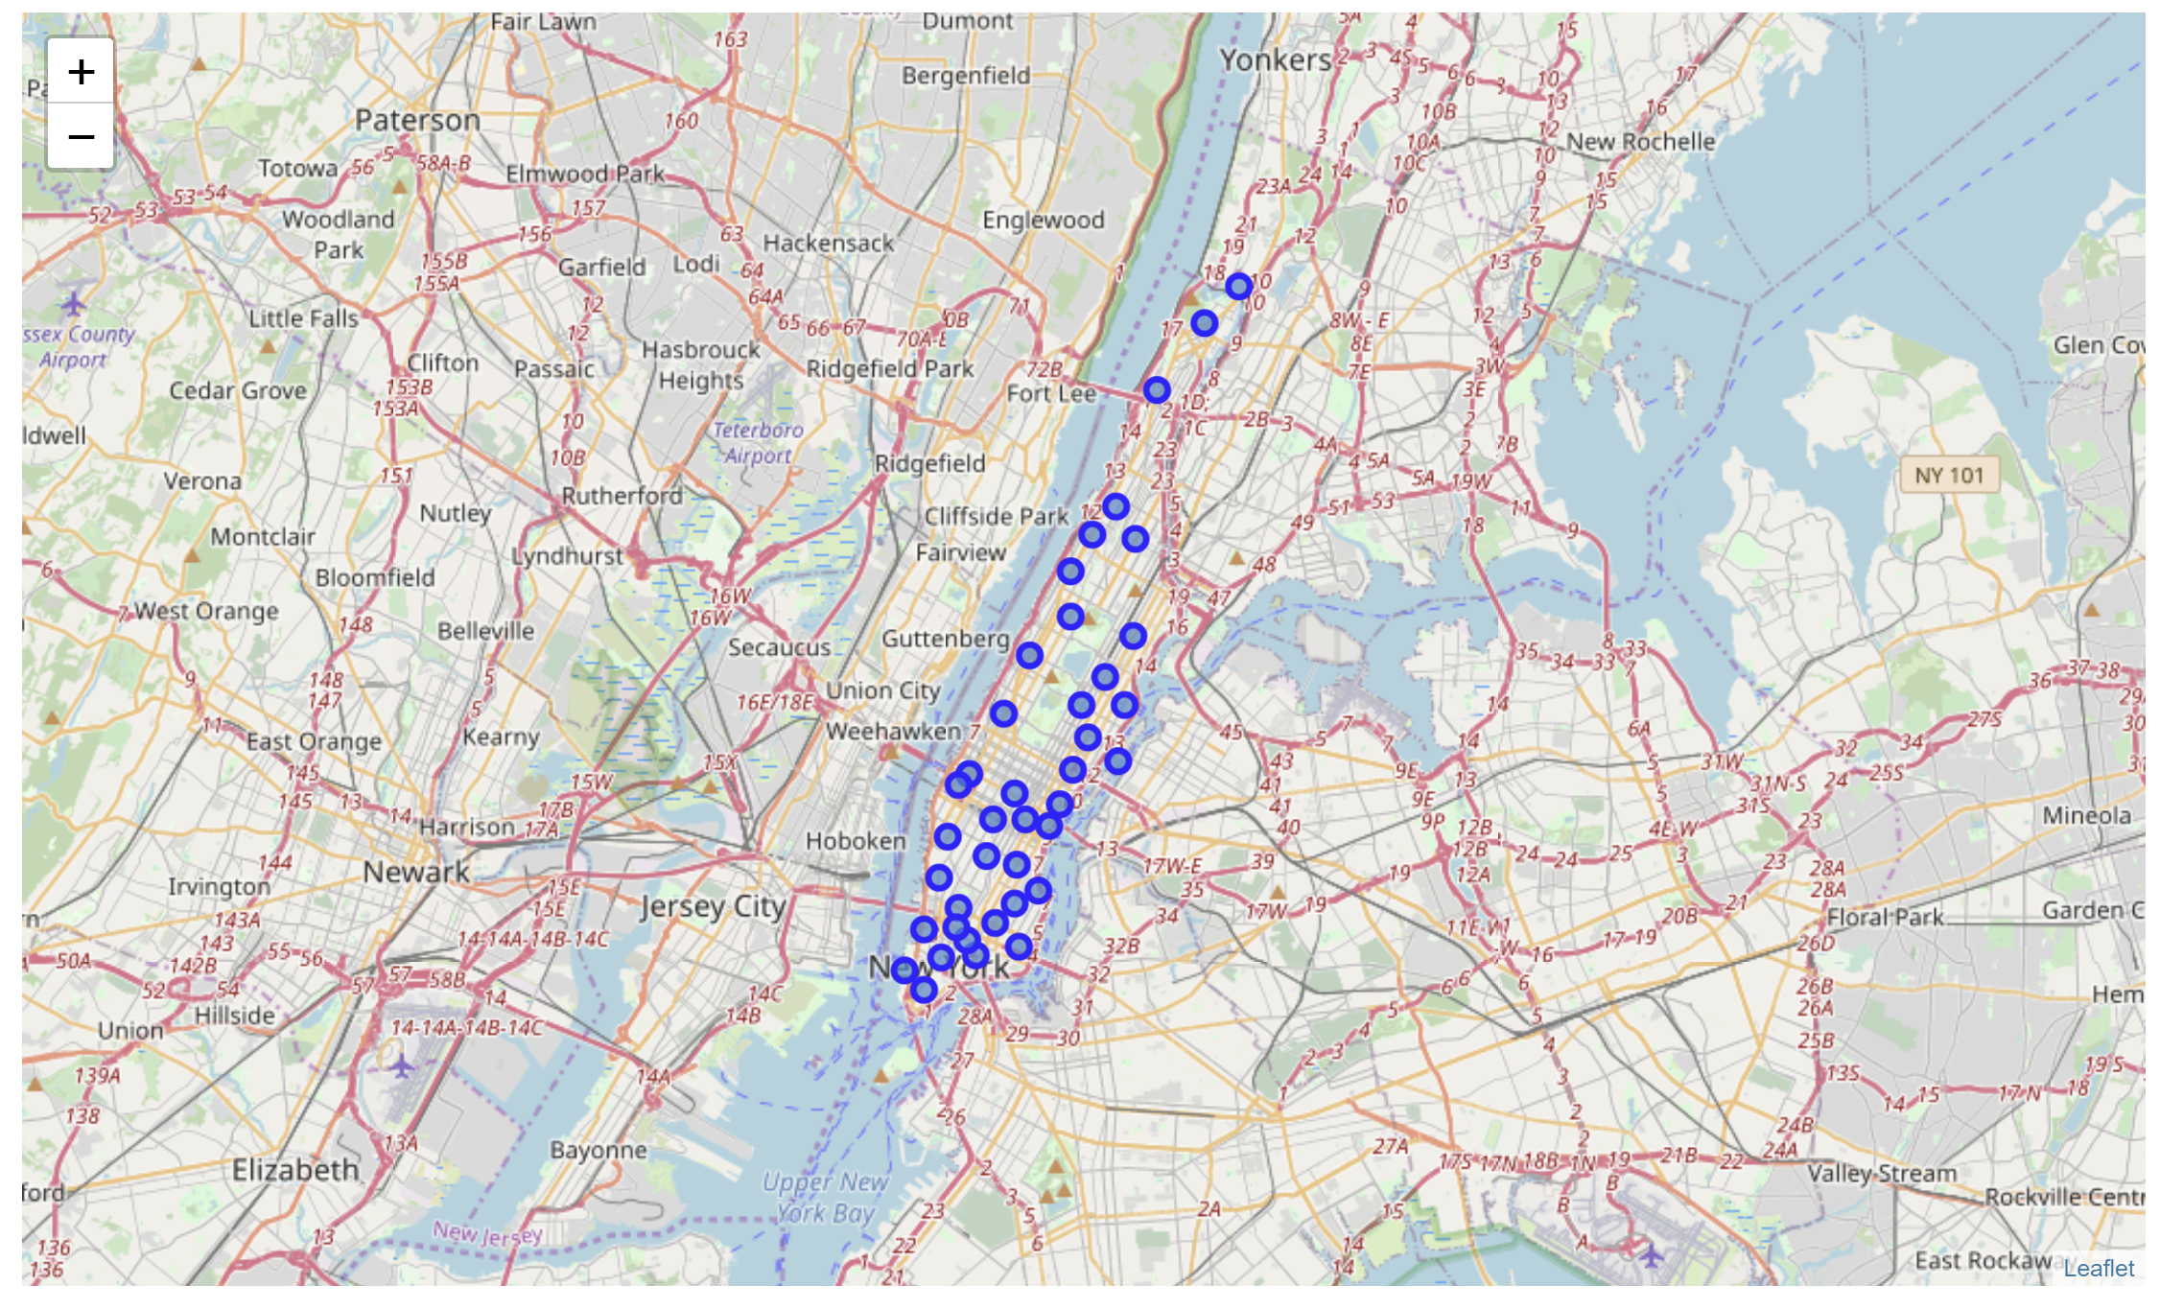
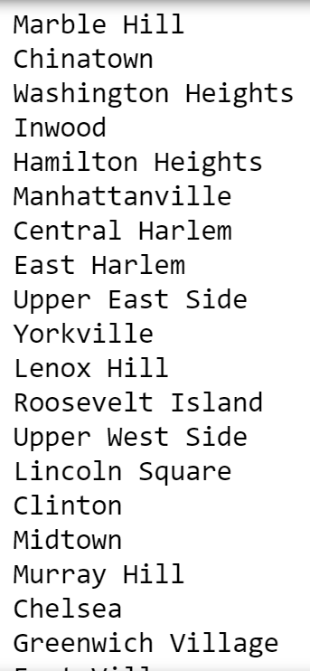
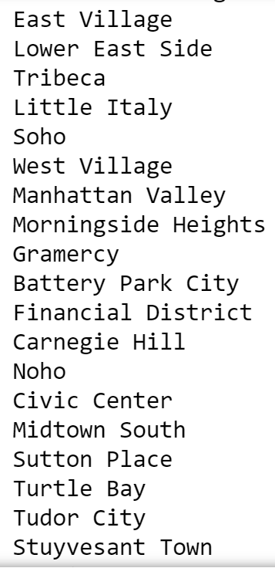
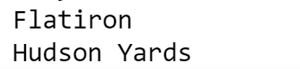
Manhattan neighborhoods

Slide 5
data
The json file of New York can be downloaded from: https://cocl.us/new_york_dataset/newyork_data.json
Neighborhood has a total of 5 boroughs and 306 neighborhoods. In order to segement the neighborhoods and explore them, we will essentially need a dataset that contains the 5 boroughs and the neighborhoods that exist in each borough as well as the the latitude and logitude coordinates of each neighborhood.

